Slide 1
Binar.ai
Austen Ang Ming Xuan, Cassandra Chew Ying Ying, Diren D. Bharwani, Leonard Lee Hon Han, Lee Ming Yang
Notes:
We are group 17 and we will be walking you through our project, Binar.ai

Slide 2





The Team
Austen Ang Dataset Curation
Cassandra Chew Dataset Curation
Diren D Bharwani Evaluation & Experimentation
Leonard Lee Convolution Neural Network
Ming Yang Lee Convolution Neural Network
Evaluation & Experimentation
2
Notes:
Introduce team members and their roles

Slide 3
Content
Binar.ai
Overview
Dataset Curation
Model Implementation (CNN)
Evaluation & Experimentation
Conclusion
Notes:
What will be covered

Slide 4

Binar.ai
Binar.ai
Image recognition algorithm that can detect fixed length handwritten binary numbers and convert them to decimals.
Notes:
Binar.ai is a (read from slide)
The objective of this project is to provide us with hands-on experience with industry frameworks and showcase the knowledge we have gained throughout the course.
The project can also serve as precursor to applications that improves the QOL of people such as Address recognition, paper forms recognition, etc.

Slide 5
Overview
Ideation
Model Implementation (CNN)
Custom Image Tests
1
3
5
2
4
6
Dataset Curation
Model Evaluation
Experimentations & Tweaking
Notes:
The entirety of project can be separated into these phases:
Ideation – Brainstormed about a problem statement and throwing out surface level ideas to get the ball rolling
Dataset curation – Created our own set of data using MNIST dataset
Model implementation – Understanding of how CNN works and implementing our own using TensorFlow
Model evaluation – Training and Testing the model against the curated training and testing datasets respectively
Custom image tests – Created a couple of our own images to test
Experimentation and tweaking – Understand what some of the hyper parameters do and to choose them wisely

Slide 6
1.
Dataset Curation

Slide 7
Dataset Curation
Why curate our own data…
No publicly available dataset
Time-consuming
Handwriting is a unique characteristic
Notes:
Some issues that we immediately came to realise was that:
There are no publicly available databases that are 4-digit handwritten binary numbers
To create our own with enough examples would be time consuming
Handwriting is unique and having all 5 members of the team creating our own dataset may not suffice

Slide 8

Dataset Curation
MNIST Database
The MNIST (Modified National Institute of Standards and Technology database) is a large database commonly used for training image processing systems. From the original NIST database, the images were normalized and centered onto a 28x28 pixel box.
Notes:
The MNIST database was chosen as the source for our dataset curation as it provides a large sample of handwritten digits that we are able to sample from and form our own 4-digit handwritten binary numbers to suit our requirements. The MNIST database is a modified version of the NIST database where handwritten digits have been extracted, normalized, and centered onto a 28x28 pixels box.

Slide 9
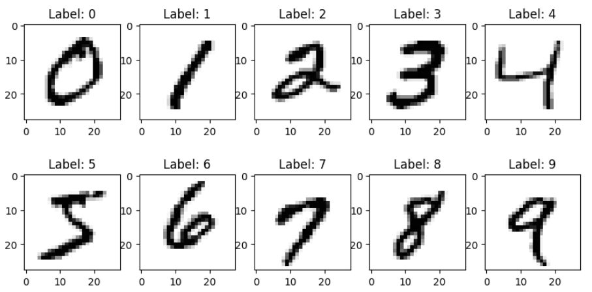

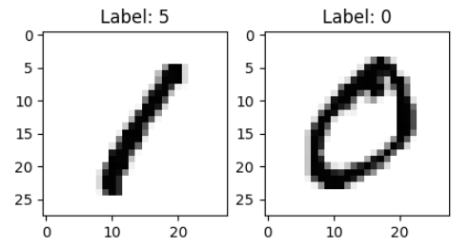
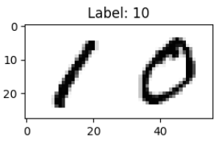

Dataset Curation
Filtering MNIST
Remove all non-zero & non-one labeled examples.
Concatenation
Joining four randomly sampled zeros or ones together.
Notes:
Dataset curation can be broken down into 2 steps:
Filtering the MNIST dataset by dropping all examples not labelled one or zero
Concatenating four randomly sampled examples to form a 4-digit binary of size 28x28 pixels. Priority goes to ensuring all 16 variations of binary numbers get created

Slide 10
2.
Model Implementation

Slide 11
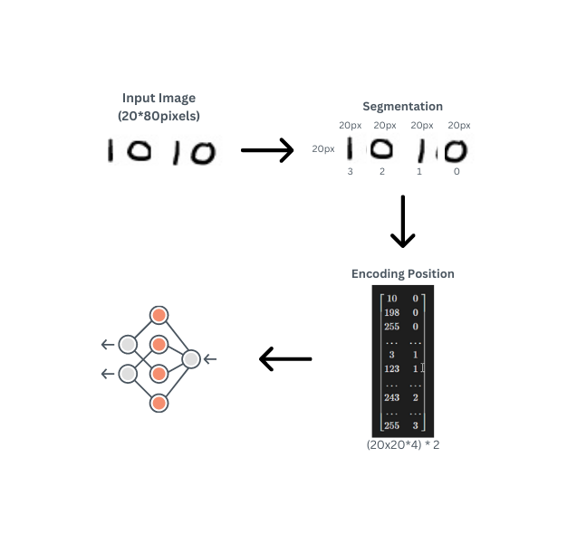
Initial Model
Dense Neural Network
Segment input image into four MNIST format images
Encode positional after flattening of image
Notes:
Initial plan was to go with a dense neural network, where we segment an image into its 4 squares and encoding the position of each square into its data before handing it off into a dense neural net. However through testing and research, we found that Dense Neural Nets requires a longer amount of time to reach convergence as compared to Convoluted Neural Networks and underperform those of CNNs

Slide 12

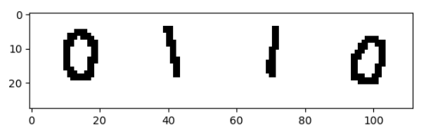
Proposed Model
15
28 x 112
16
Notes:
Hence the new model removes all of the intermediary steps and uses the curated images as inputs for CNN. Not only does this eliminate computation required to segment the images before training, we also gain improved performance through the use of CNN kernel magic for image detection.
The architecture of the new model is as shown:
One input layer (Image)
2D Convolution Layer with Rectified Linear Unit(ReLU) as an activation function
Max pooling layer
Another 2D Convolution Layer with ReLU as an activation function
Max pooling layer
Followed by a flattening layer before two more dense layers, using relu and softmax
Output layer

Slide 13
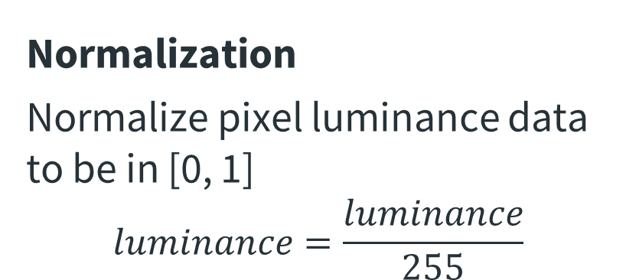
Data Transformation
Normalization
Normalize pixel luminance data to be in [0, 1]
$$luminance=\frac{luminance}{255}$$
One-Hot Encoding
Turn labels which are ordinal into categorical data
5 → [0, 0, 0, 0, 0, 1, 0, ..., 0]
Ordinal Categorical
Notes:
Before we train the model, we perform normalization on the feature set to improve the performance of the model, as well as to change ordinal labels into categorical one to suit the classification problem statement.

Slide 14
Training & Testing Sizes
Training
96,000 training examples
6,000 per binary variation (E.g. 0000, 0001, …, 1111)
Testing
32,000 training examples
2,000 per binary variation (E.g. 0000, 0001, …, 1111)
Notes:
The original training and testing sets are of the following sizes, where variation in this case refers to one of the 16 binary combinations possible with 4 bits

Slide 15
3.
Evaluation & Experimentation

Slide 16
Overfitting
Expand Training Set
Generated a larger training set using our data curation method.
Regularization
Added Dropout layers in the model.
Increase Batch Size
By increasing the batch size, we reduce the impact of noisy samples.
Notes:
When training our model we noticed that overfitting has occurred when the training accuracy was higher than the validation accuracy by a huge margin. To tackle this issue,
Expanded our training set from 96,000 examples to 480,000 examples
Applied regularization technique by adding a dropout layer with a dropout rate of 0.5
Increase the batch size from 64 to 128 which helps in reducing noise
After performing these optimizations, the validation accuracy could be seen to have increased from 6% to 16.63%, while using the Adaptive Moment Estimation optimizer boosted it up to 16.64%

Slide 17
Evaluation
Notes:
Now that we got that out of the way, let’s look at some metrics.
An interesting insight was that after we evaluated both models against the same test set, the original model seemed to have performed better than the supposed optimized model.
This is actually expected since the optimized model contains several dropout layers, and when trained on the same expanded dataset, the training accuracy of the optimized model would be lower than the original.

Slide 18
Experimentation
Epoch
Batch Size
Notes:
When we looked further into how we can tweak the hyperparameters, we found out that after a certain number of epochs, the training accuracy of the model tend to flatten out. This is due to the model having learned most or all of the important features of the data. Hence it might be a good idea to stop training after the accuracy begin to stagnate to save on training time.
We have previously dealt with batch sizes when we attempted to handle the overfitting problem. When experimenting with different batch sizes, we’ve learnt that with the smallest batch size of 1, we are performing more individual back-propagations through the network, over-emphasizing individual effects, taking more time due to having to perform more back-propagations.
On the other hand, having a large batch size, let's say the size of the input, would mean that we are averaging the result of all the images, and then performing one back-propagation on the network. This might lead to us missing some little-seen features.

Slide 19
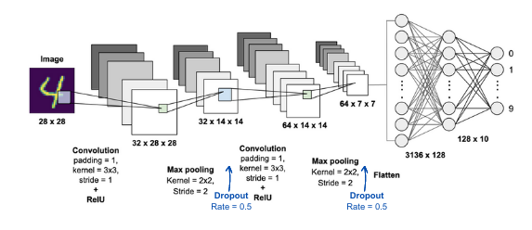
Final Model
15
28 x 112
16
Notes:
Now let’s put them all together. We include the dropout layers for regularization, and while training, we stop use Early Stopping to stop training when validation loss stagnates.

Slide 20
Final Model
Notes:
And when comparing the new model with the original model and the “optimized” model, we see that the Final model slightly outperforms the Optimized model but still loses out to the Original model on Testing accuracy. In future works, it may be a good idea to look into how we are able to better clean, process, or even curate the input data to improve both validation performance and testing accuracy.
Before we end off, we also want to make a note that using our own custom images proved to be difficult as the training data has been curated form the MNIST dataset, which makes inputs very sensitive to the MNIST format. Any slight violations to the MNIST format, such as exceeding the inner 20x20 border throws the prediction off completely. The best data in this case would be to either manually create our own examples, or to remove the outer border of the MNIST example and concatenate those instead.

Slide 21
Conclusion
Industry Frameworks Familiarisation
Problem-Solving Models
Knowledge into Practice
Notes:
Now that we have come to the end of this project, we are proud to say that there have been many takeaways
Work with industry frameworks
Problem solve an under performing model
Navigating ML API libraries
Putting what was taught in class into practice

Slide 22
Thanks!

Slide 23
Toolkits
TensorFlow
Matplotlib
NumPy
Notes:
Some issues that we immediately came to realise was that:
There are no publicly available databases that are 4-digit handwritten binary numbers
To create our own with enough examples would be time consuming
Handwriting is unique and having all 5 members of the team creating our own dataset may not suffice

